Slide 1
Classifying Breast Cancer Stage
Vlado Ovtcharov
Indica Labs

Slide 2
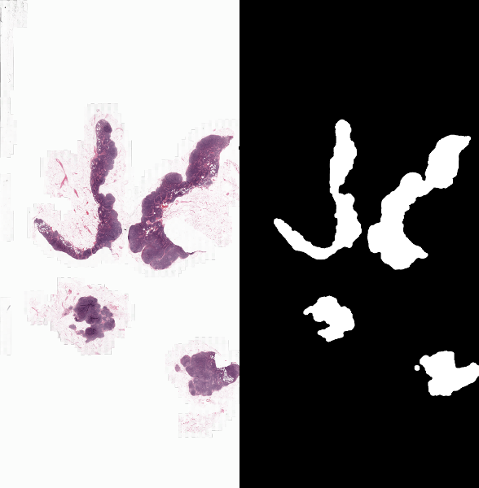
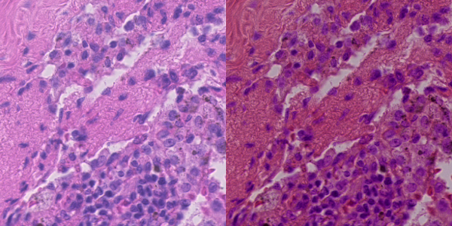
Pre Processing
Tissue Detection (Otsu Threshold)
Augmentation (rotation, color)

Slide 3
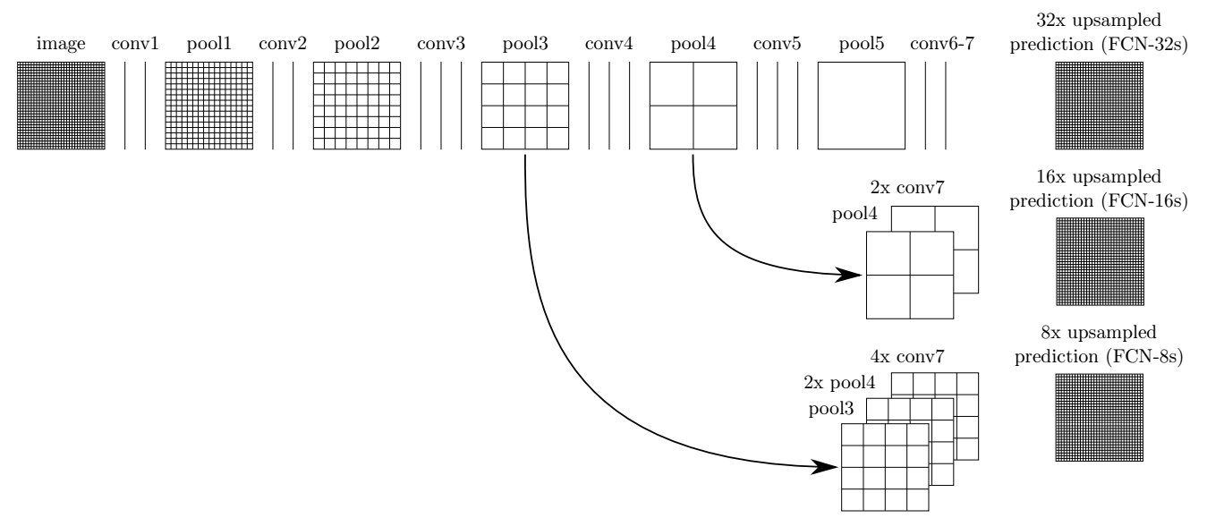
Training
FCN-VGG Network
Removed padding
Small output size
Hard Labels
Balanced Sampling
RMSProp
(lr 1e-3, decay 0.9/10k iterations)

Slide 4
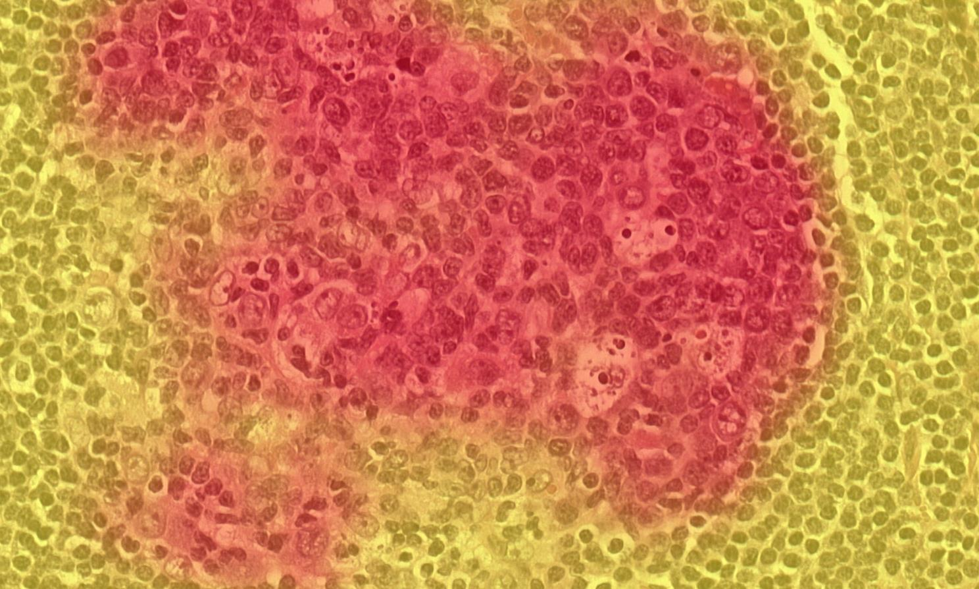
Classifying
Large input size
Two Titan-X for ~3 days
Thresholding at three levels
(50%, 95%, 99%)
Use major axis for classifying
Average from three thresholds
Total Area for disjoint tumors
Reduce false positive itc with 99% threshold

Slide 5
Failed Approaches and Open Questions
Inception/resnet networks
  Slow classification
  Padding Issues (batch norm?)
Hard data mining
Cell based classifier
Random Forest

