Slide 1
CAMELYON17 CAncer MEtases in LYmph Nodes ChalleNge 2017
Geert Litjens, PhD. Department of Pathology
Raboud University Medical Center
Nijmegen, The Netherlands

Slide 2
Challenges in medical imaging

Slide 3
Challenges in medical imaging
Fair comparison of algorithms
Same evaluation metric
Same ground truth definition
Same training and test datasets
First challenges in medical imaging in 2007
SLIVER07 and CAUSE07 for liver and caudate segmentation
Currently 142 challenges registered at www.grand-challenge.org

Slide 4
Challenges in medical imaging
Challenges in organizing challenges
Define a meaningful task
Gather representative data
Define the reference standard
Define a discriminative evaluation metric
Publicize your challenge
Define a long-term strategy

Slide 5
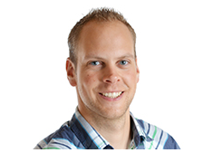
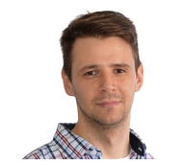
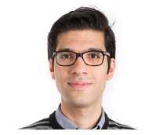
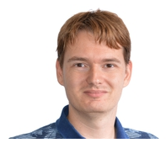
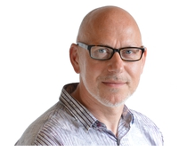
Organizing committee
Oscar Geessink
Péter Bándi
Babak Ehteshami
Geert Litjens
Jeroen van der Laak

Slide 6
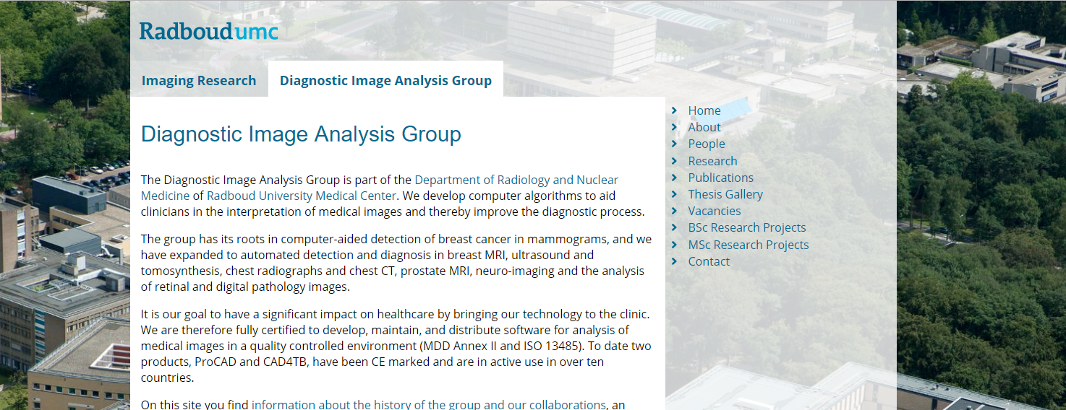
Organizing committee
http://www.diagnijmegen.nl

Slide 7
Sponsors

Slide 8
Program
09:00 |  | Geert Litjens |  | Welcome and introduction
09:15 |  | Oscar Geessink |  | Lymph node metastases
09:25 |  | Babak Ehteshami Bejnordi |  | Looking back at CAMELYON16
09:45 |  | Oscar Geessink |  | Moving the challenge to patient level
09:55 |  | Péter Bándi |  | Technical aspects and evaluation​
10:15 |  | Team VCA-TUe |  | Summary of methods
10:30 |  | Coffee break
11:00 |  | Team ​MIL-GPAT |  | Summary of methods
11:15 |  | Team ​HMS-MGM-CCDS |  | Summary of methods
11:30 |  | Team DTU |  | Summary of methods
11:45 |  | Team Indica Labs |  | Summary of methods
12:00 |  | Péter Bándi Oscar Geessink |  | Results and announcement of winner
12:30 |  | End

