Slide 1
CAMELYON16 Challenge Matt Berseth, NLP Logix Jacksonville FL

Slide 2
Overview
Preprocessing
Training
Post- processing

Slide 3
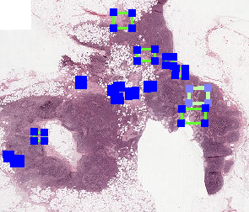
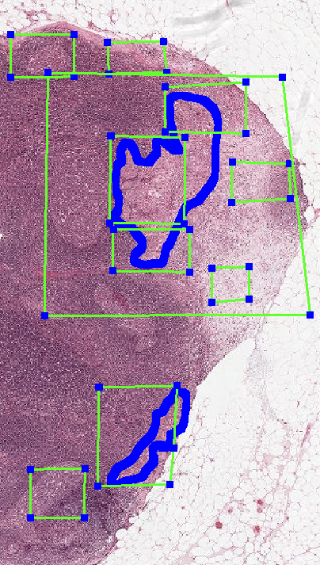
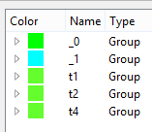
Preprocessing - Annotation
t1/t2: Tumor Slides
t3: Non Tumor Slides
t4: Validation Patch

Slide 4
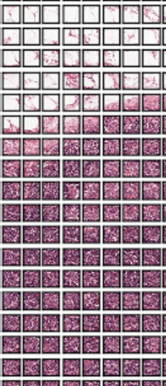
Preprocessing - Annotation
256x256 Non-overlapping patches
Label assigned at 50% overlap
250,000 patches / 15% positive
80/20 train / xval split (full slide)

Slide 5
Network Architecture & Training
6 conv layers, 2 fully connected layers, 256x256x3
Gradient descent, 50 images per batch
Each image presented approx. 10 times
Random flip and rotation
No dropout (no time)
No hyper-parameter tuning (no time)
AlexNet

Slide 6
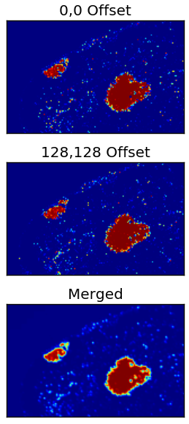
Test Slide Scoring
Each slide scored twice
256x256 patches, 128 offset
Patch ignored if 90% of pixels are same color
No augmentation at test time

Slide 7
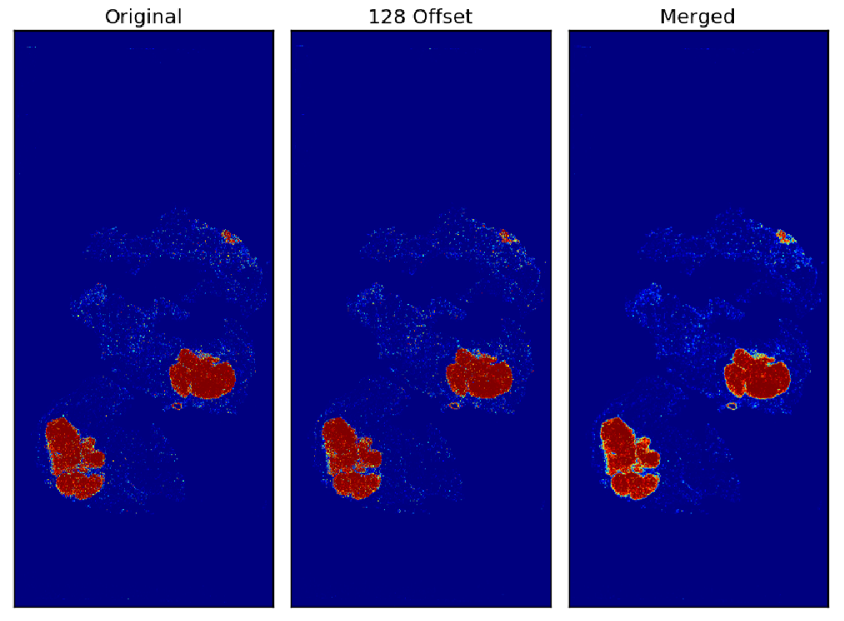

Slide 8
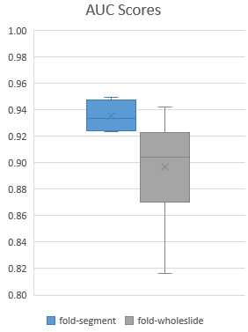
Whole Slide Estimate
Segment scored slide into 12 chunks
Positive label if chunk overlaps with mask, otherwise negative
Compute features over each chunk
4,800 image chunks for training
Random Forest, 10 model ensemble, max of chunks

Slide 9
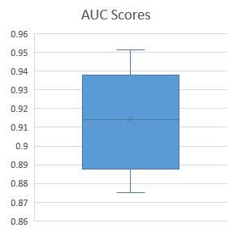
Localization Estimate
GrabCut & Watershed clustering
Local max pixel for each cluster used as candidate
37,000 training examples
Random Forest, 10 model ensemble

Slide 10
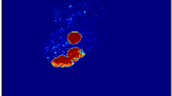
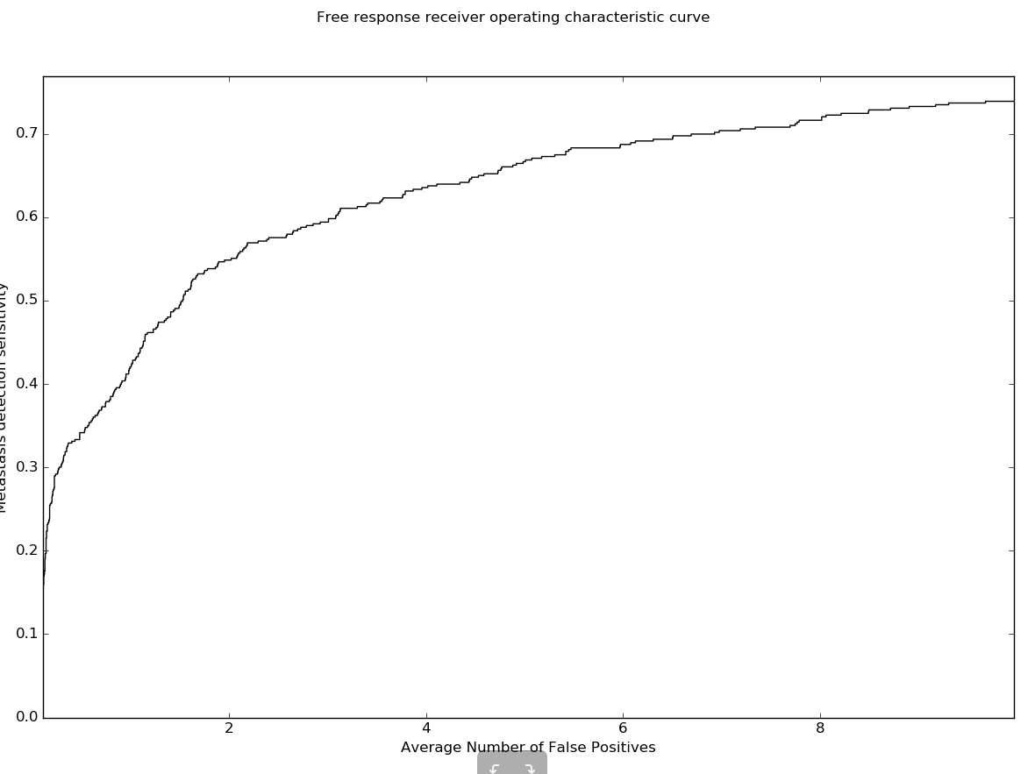
Localization Estimate

Slide 11
Overview
Preprocessing
Training
Post- processing
25% of GPU Time
60% of Dev Time
75% of GPU Time
10% of Dev Time
30% of Dev Time

Slide 12
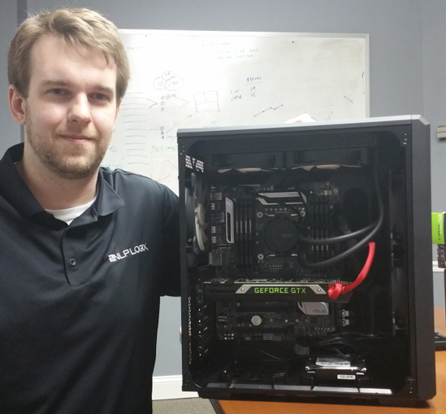
Software & Hardware
ASAP
Openslide
TensorFlow
Python / Numpy
AWS
Nvidia / CUDA
Julia

Slide 13
Questions

